Slide 1
Virtualización
Un poco de historia
o Qué es y para qué sirve.
o Cuales opciones para servidor existen en el mercado (gratis y de pago)
▪ Crear un cuadro comparativo.
o Citar ventajas y desventajas de la virtualización.
o Mostrar un demo funcional a la clase.
▪ Requerimientos de instalación.
▪ Mencionar puntos importantes durante la instalación y configuración

Slide 2
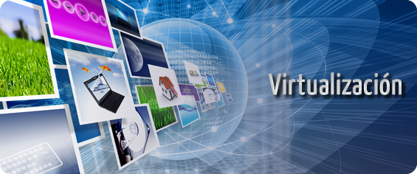
WORKSHOP #1

Slide 3
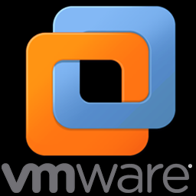
Agenda
History
What is it and what is it for.
Server options available in the market (free and paid)
Advantages and disadvantages of virtualization.
Showing a functional demo to the class.
Installation requirements.
Important points during installation and configuration.

Slide 4
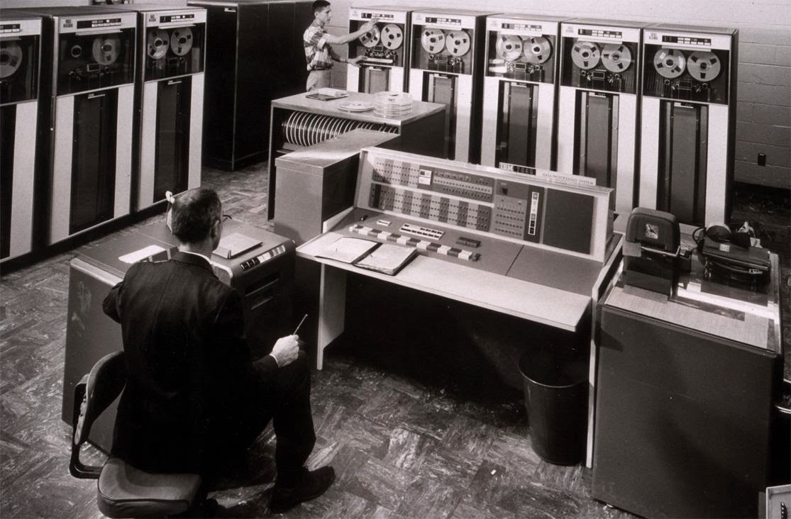
History
Virtualization is a technology that was developed by IBM in the 60s. The first computer designed specifically for virtualization was the IBM S / 360 Model 67 mainframe.

Slide 5
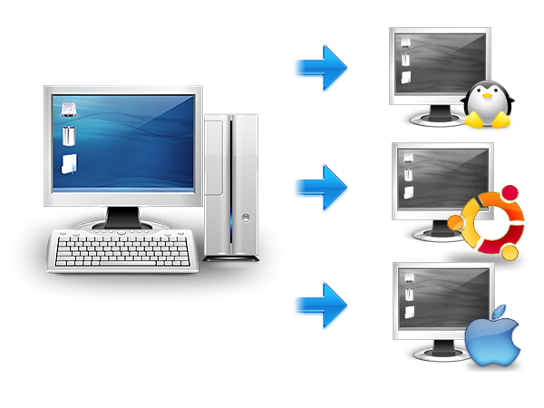
What is virtualization?
Virtualization is the process of creating a software-based (or virtual) representation, rather than a physical one. Virtualization can be applied to servers, applications, storage and networks, and is the most effective way to reduce IT costs and increase the efficiency and agility of any size business.

Slide 6
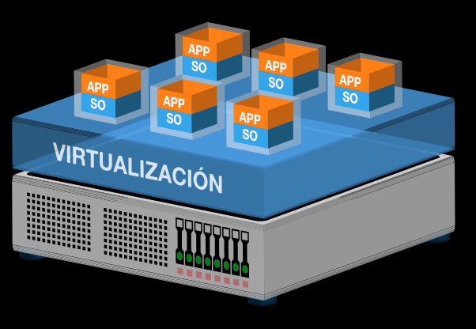
What is it for ?
For developers: using this technology it is possible to install different operating systems, security patches, own or third-party developments.
In production environments: useful to ensure business continuity taking advantage of downtime.
Centralize: thanks to virtualization it is possible to carry out prevention activities, such as backups, from the virtual machine manager.
Redistribute resources from physical servers.
Hardware Emulators: Replace workstations with silly terminals.

Slide 7
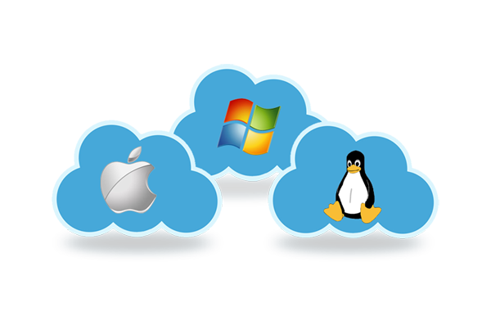
Operating systems for servers.

Slide 8
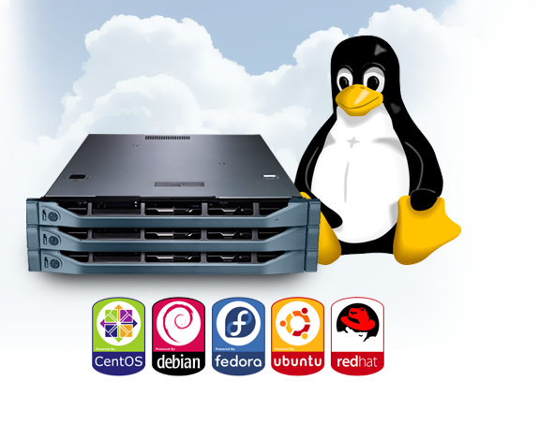
LINUX
Best cost of the market, free or a symbolic price for the cd.
• Huge amount of free software.
• Greater stability for something they use in high performance servers.

Slide 9
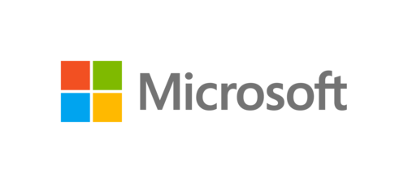
Windows
It has the most software developed.
Most viruses are made to win You may have compatibility errors in new systems.
New versions require many resources
Windows 2000.
Windows 2000 Server
Windows Server 2003.
Windows Server 2008.
Windows Server 2008 R2.
Windows Server 2012.
Windows Server 2016.
Windows Small Business Server
Windows Essential Business Server
Windows Home Server.

Slide 10
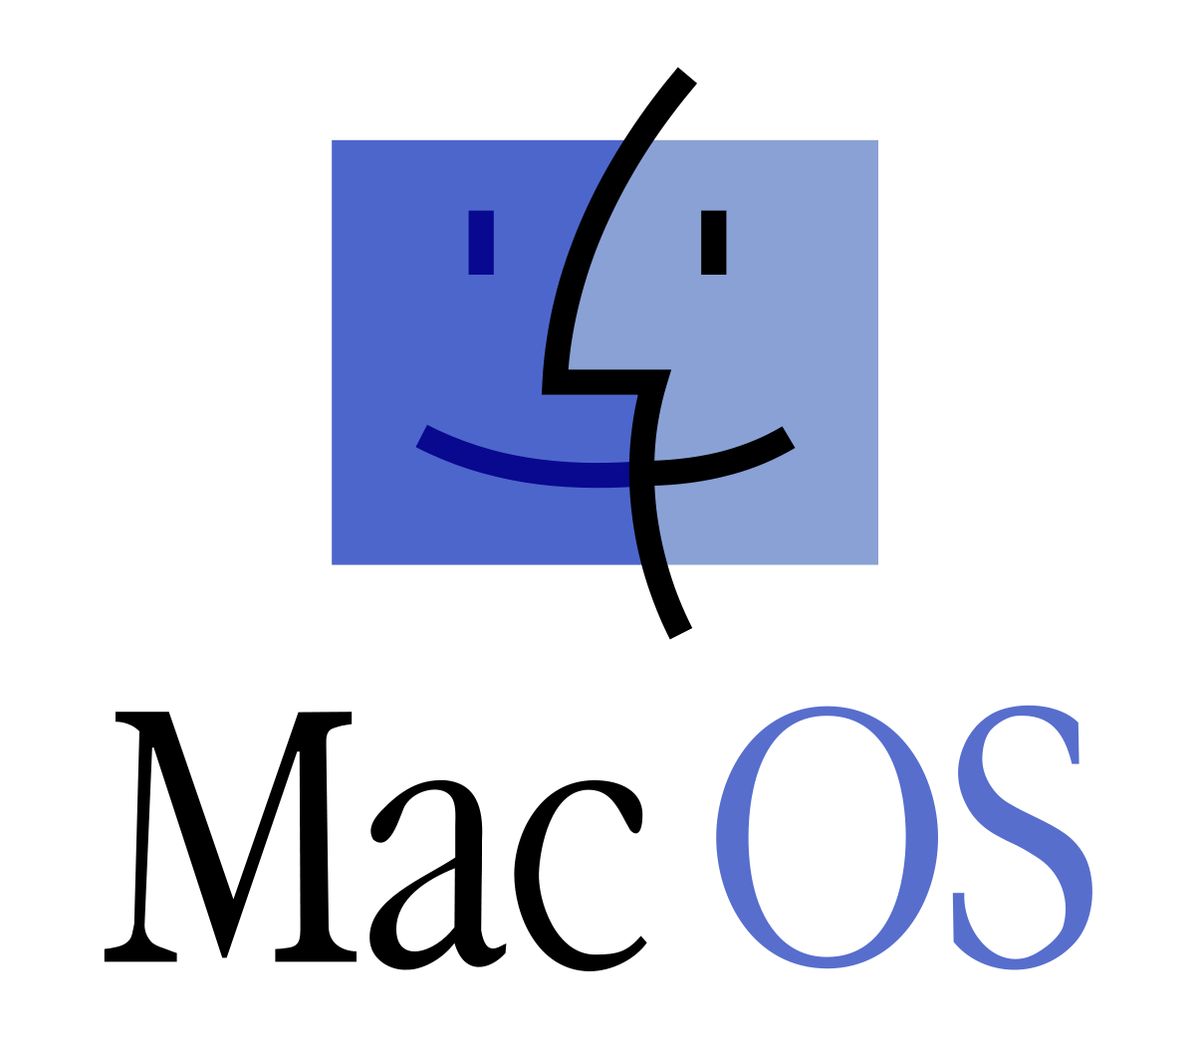
MAC
Best graphical interface on the market
It is very stable
It is less vulnerable to viruses and malware
Mac OS X Server 10.0 (Cheetah Server)
Mac OS X Server 1.0 (Rhapsody
Mac OS X Server 10.1 (Puma Server)
Mac OS X Server 10.2 (Jaguar Server)
Mac OS X Server 10.3 (Panther Server)
Mac OS X Server 10.4 (Tiger Server)
Mac OS X Server 10.5 (Leopard Server)
Mac OS X Server 10.6 (Snow Leopard Server)
Mac OS X 10.7 (Lion Server)
Mac OS X 10.8 (Mountain Lion Server)

Slide 11
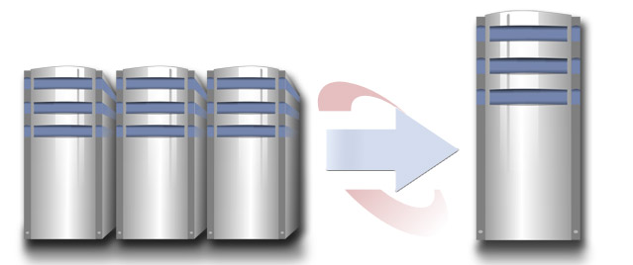
Advantage
Rapid incorporation of new resources for virtualized servers.
Reduction of space and consumption costs.
Reducing IT costs through increased efficiency and flexibility in the use of resources.
Centralized and simplified global administration.
It allows us to manage our CPD as a pool of resources or pool all the processing capacity, memory, network and storage available in our infrastructure
It not only brings the direct benefit in reducing the necessary hardware, as well as its associated costs
Reduces stopping times
High degree of overall satisfaction

Slide 12
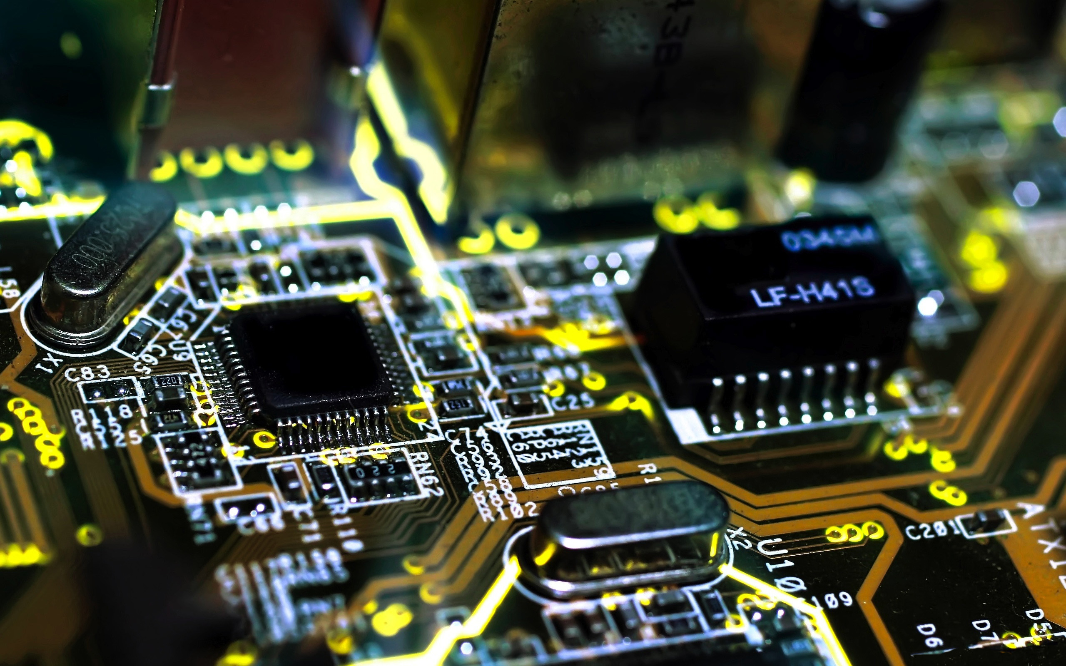
Disadvantages
Increase of initial costs
Investment in software to manage servers.
Need to learn how to handle the new virtual environment.
Lower performance

Slide 13
Virtualización

Slide 15
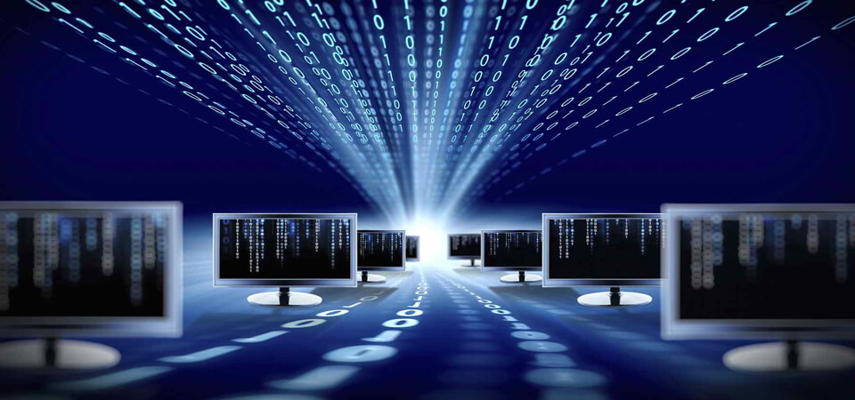

Taller #1 Virtualización.
Oscar Vega.
Kevin Arias.
Roque Chacón.

